Slide 1



SOUNDEC
Super Noise Cancelling ENC Headset Solution
For Unsteasy Noise
2022/04/07

Slide 2
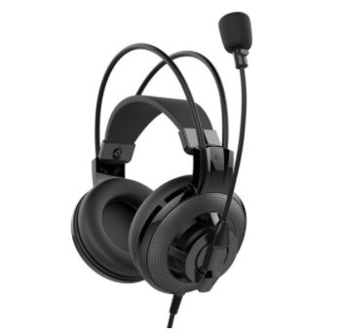
Soundec Solution Introduce
Soundec Solution
Super noise reduction technology
The 2-mic call noise reduction solution is adopted to filter 90% of the ambient noise and surrounding human voices, and can clearly capture the operator's voice to ensure high-quality voice conversations with the far end.
Existing products in the market
Diversified solutions
Using a unidirectional electret microphone
1、Very poor call noise reduction
2. Poor call quality
Brings more inconvenience to the work of the operator
Single-Chip supports USB headset complete solution
Support bluetooth headset solution with bluetooth chip
Broadband Voice Full coverage of voice and audio
Supports up to 6.8KHz wideband voice for more natural and clearer voice when using IP phone and softphone systems
Dynamic sound enhancement
Different from traditional EQ sound ，Adopt exclusive dynamic enhancement algorithm，Support 20-20KHz full-band multimedia playback，Provides high-quality music output
Plug and Play Multi-Platform Compatibility
Compatible with a variety of platforms, it supports USB drive-free direct plug-in on PC, and can be used with UC clients such as Microsoft Skype for Business, Avaya, Cisco, Lync and so on through the computer
Realize the function of Sidetone
Extremely low-latency Sidetone function, allowing you to monitor the sound in time

Slide 3

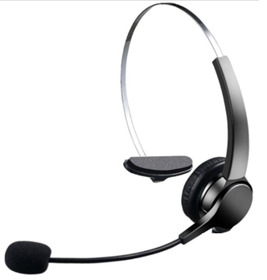
The Function description
1)Functional composition
Dual Mic Topology + Single/Dual Speaker Headphone Structure
2)Instructions for use environment
In noisy indoor and outdoor environments (80dB typical noise environment, up to 90dB noise), the call sound heard by the far end (the other party) can be clear and coherent
Eliminate non-stationary noise (random music) played in a call environment
Eliminates steady-state noise (white and pink noise) played in a call environment
Eliminate other background noise (keyboard, human voice) present in the call environment
3) Line control button function:
Support volume addition and subtraction, mute, answer, noise reduction function switch, Sidetone function switch
4) Single-Chip can support complete USB wired headset functions:
Support two analog microphones, direct push speakers, support USB Audio
ENC Mic
Speaker
TalkMic

Slide 4
Mic selection requirements and suggestions
1. TalkMic main microphone specifications
Electret directional microphone
Recommended diameter: 9.7mm~10mm
Sensitivity: -38dB±2dB/ -40dB±1dB
2. RefMic reference microphone specification requirements
Electret omnidirectional microphone
Diameter requirement: none
Sensitivity: -40dB±2dB/-42dB±1dB
RefMic
Speaker
TalkMic
Remarks: The mic sensitivity is only used as an empirical reference, because the mic of each manufacturer are different, and the mic sensitivity needs to be adjusted according to the actual effect.

Slide 5
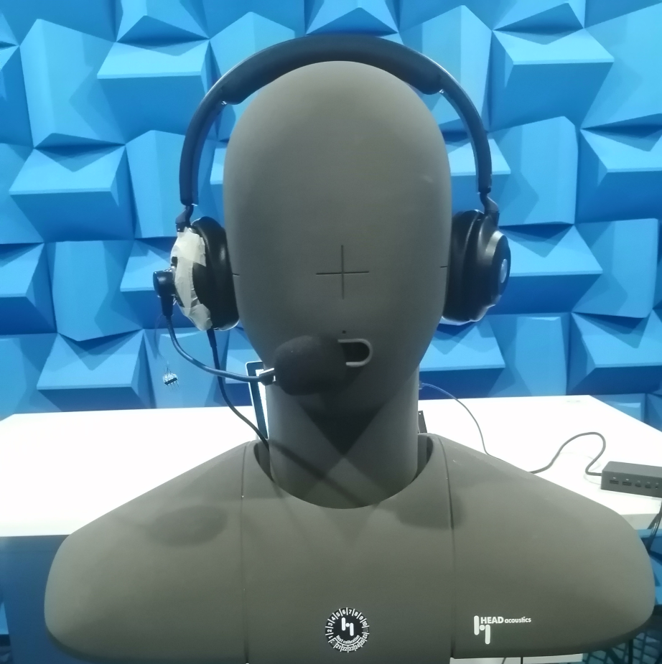
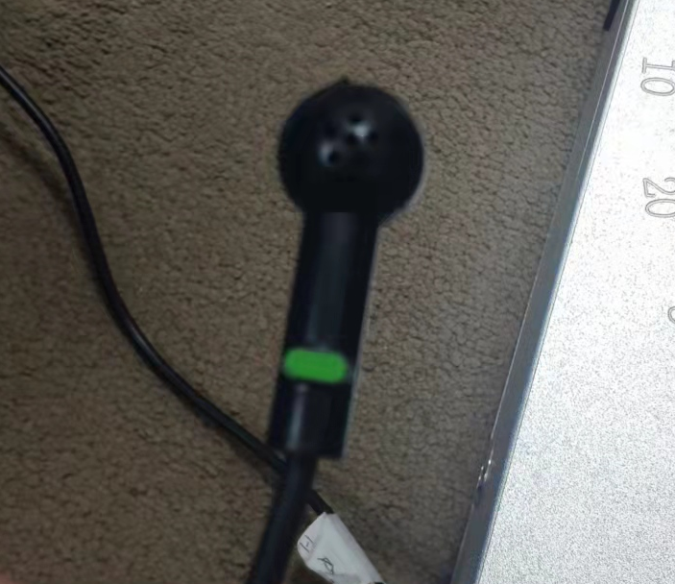
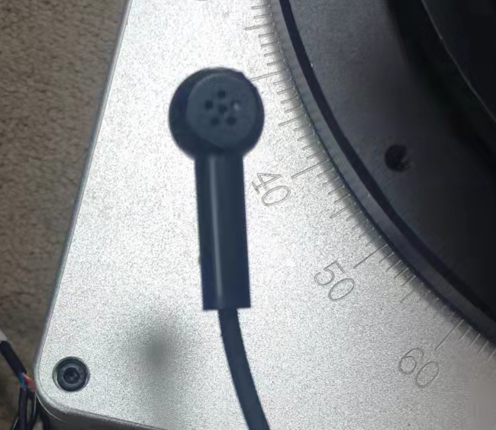
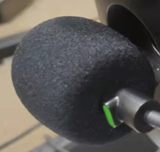
Mic structure design requirements
1. Both the front and back sides of the TalkMic need to have holes (directional microphones)
2. Need to install anti-spray cotton, you can choose to design the front and back of the Mic inside the plastic
3. The total length of the Mic pole: 18cm~20cm, so that the main microphone can be close to the user's mouth
4. The noise-cancelling mic is designed in the earmuff, and the hole is punched to pick up the sound.
5. The design of the two microphones should have good sealing and shock-absorbing materials

Slide 6
System Block Diagram（USB Single Speaker）
SNC86**
talkMic
AMIC1
Alg
refMic
AMIC2
USB
Up Link
PC/phone
Down Link
DAC
refMic
I2S
(Slaver)
AOHPRP
LRCK
AOHPRN
Speaker
BCK
Speaker
AOHPLP
SDI
talkMic
AOHPLN
SDO

Slide 7
System Block Diagram
（Bluetooth Single/Binaural Speaker，SNC86**Digital output）
SNC86**
Bluetooth
talkMic
AMIC1
Alg
refMic
AMIC2
DAC
Speaker
I2S
(Slaver)
I2S
(Master)
LRCK
LRCK
LRCK
LRCK
BCK
BCK
RF
BCK
BCK
SDI
SDO
SDI
SDO
Rx
PC/phone
SDO
SDI
refMic
SDO
Tx
Uart/
I2C(Slaver)
Uart/
I2C(Master)
Speaker
talkMic

Slide 8
System Block Diagram
（Bluetooth Single/Binaural Speaker，SNC86**Analog output）
SNC86**
Bluetooth
talkMic
AMIC1
Alg
refMic
AMIC2
DAC
Speaker
DAC
ADC
I2S
(Slaver)
AOHPRP
LRCK
AOHPRN
RF
BCK
AOHPLP
SDI
Rx
PC/phone
RefMic
AOHPLN
SDO
Tx
Speaker
Uart/
I2C(Slaver)
Uart/
I2C(Master)
TalkMic

Slide 9
Thanks

